Slide 1
Using metabolic modelling to understand the limitations to photosynthesis under changing environmental conditions
Helena Herrmann, Jean-Marc Schwartz, Giles Johnson

Slide 2
Using metabolic modelling to understand the limitations to photosynthesis under changing environmental conditions
Helena Herrmann, Jean-Marc Schwartz, Giles Johnson

Slide 3
Using metabolic modelling to understand the limitations to photosynthesis under changing environmental conditions
Helena Herrmann, Jean-Marc Schwartz, Giles Johnson

Slide 4
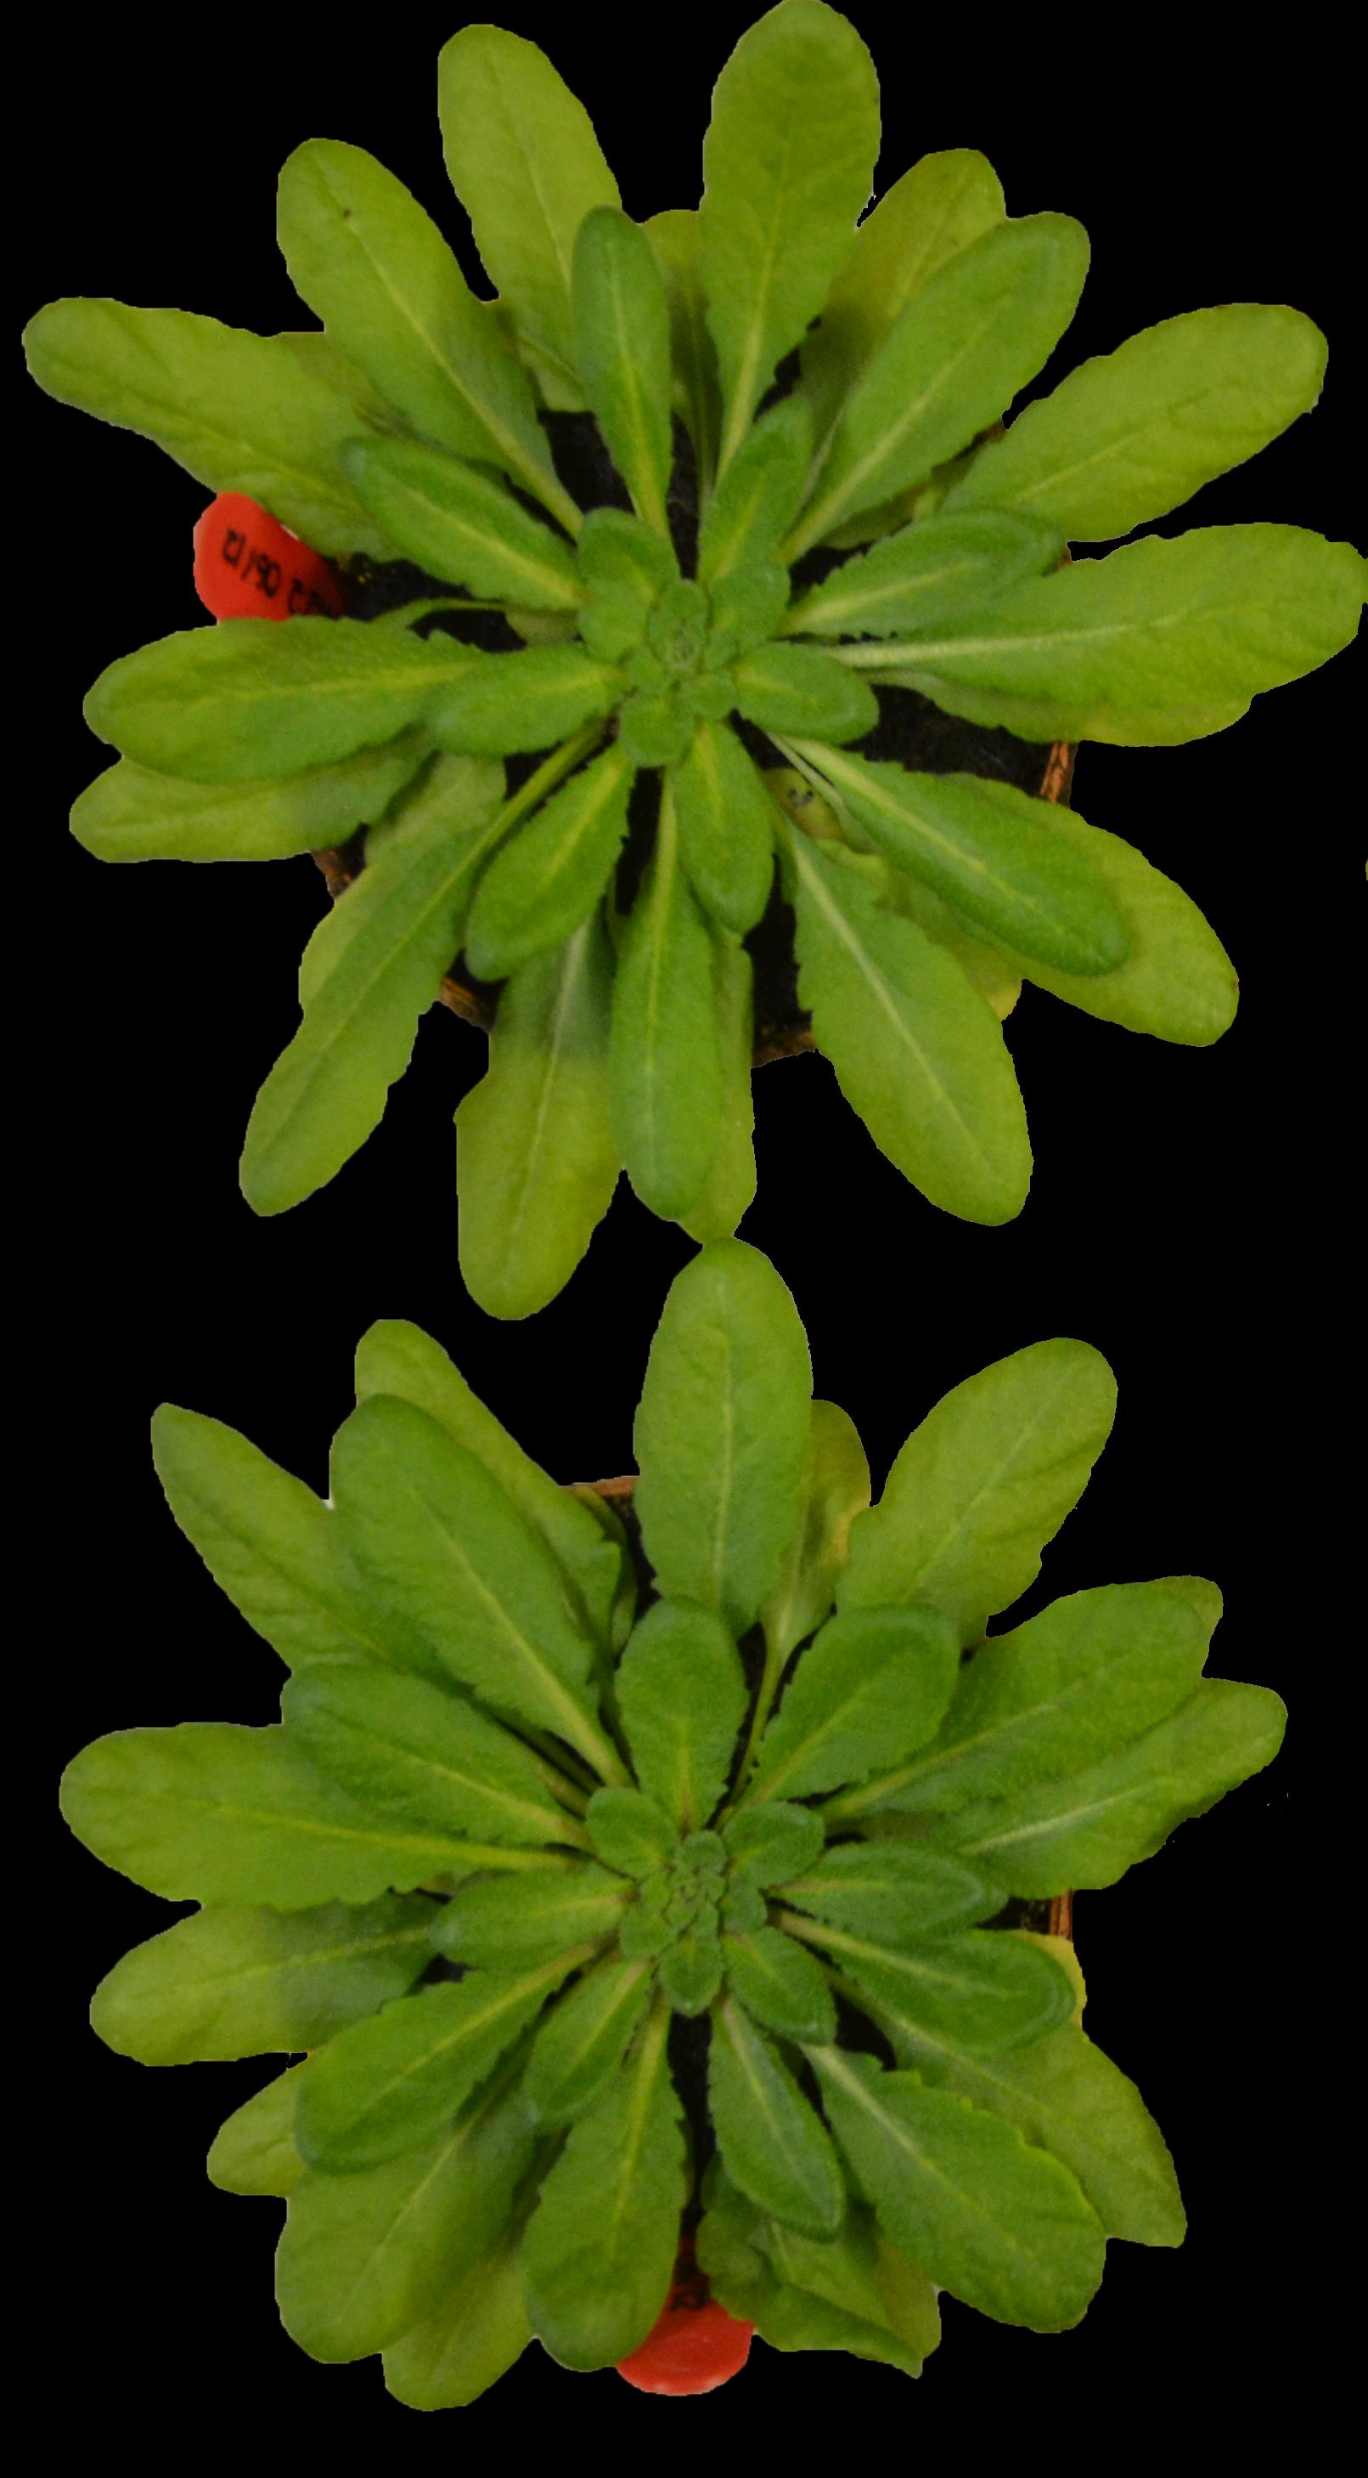
Dynamic Acclimation One week of temperature treatment on adult plants

Slide 5
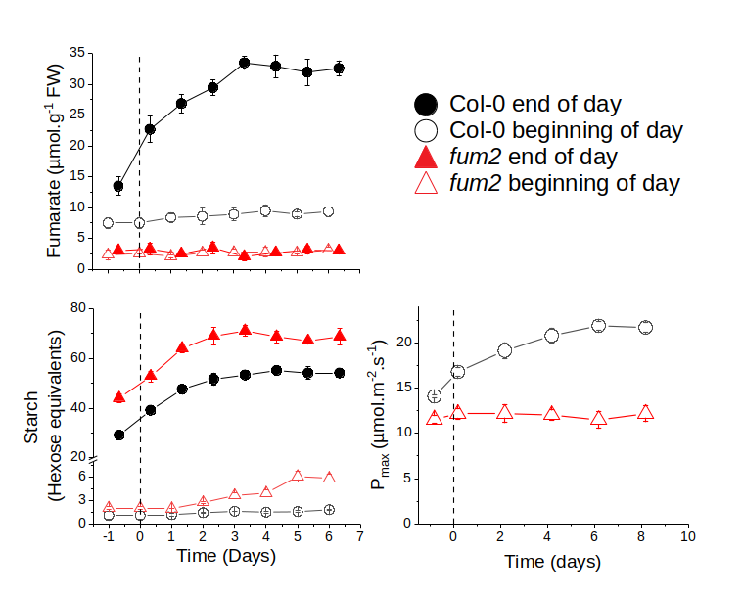
Dynamic Acclimation One week of temperature treatment on adult plants
Photosynthesis and metabolism reach a new steady state upon temperature acclimation

Slide 6
Steady State
Photosynthesis and metabolism reach a new steady state upon temperature acclimation

Slide 7
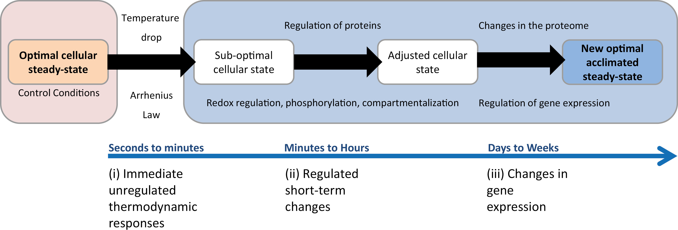
Steady State
Photosynthesis and metabolism reach a new steady state upon temperature acclimation
Herrmann et al. 2019, JXB

Slide 8
Steady State Constraint-based modelling (CBM)
Photosynthesis and metabolism reach a new steady state upon temperature acclimation
Notes:
Increased carbon storage in the cold
EOD-BOD concentration values applied as 8h fluxes to storage reactions

Slide 9
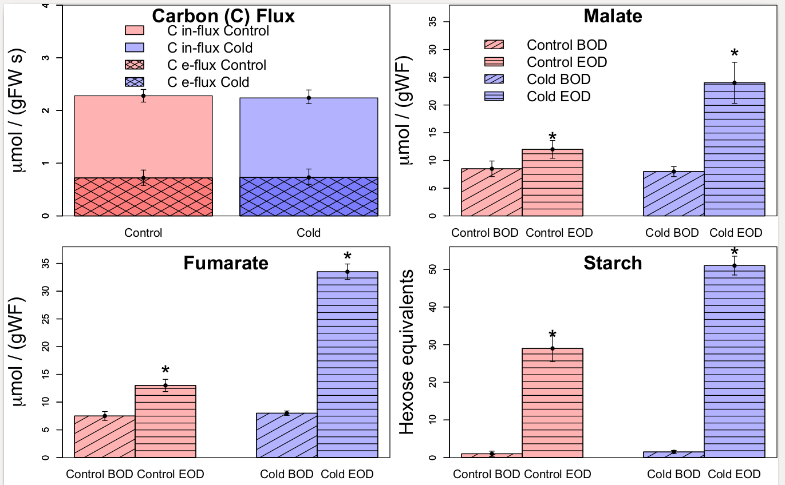
Steady State Constraint-based modelling (CBM)
Photosynthesis and metabolism reach a new steady state upon temperature acclimation
Notes:
Increased carbon storage in the cold
EOD-BOD concentration values applied as 8h fluxes to storage reactions

Slide 10
Steady State Constraint-based modelling (CBM) But what to set as the objective function(s) ?
Photosynthesis and metabolism reach a new steady state upon temperature acclimation

Slide 11
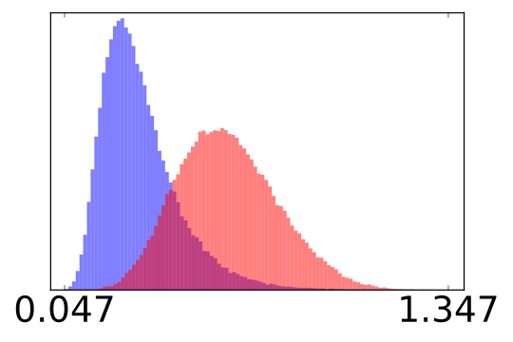
Flux Sampling: A Powerful Tool to Study Metabolism under Changing Environmental Conditions Herrmann et al. 2019, submitted
COBRA(py)
ACHR OPTGP CHRR
Run time & Convergence across 3 metabolic models

Slide 12
Flux Sampling: A Powerful Tool to Study Metabolism under Changing Environmental Conditions Herrmann et al. 2019, submitted
COBRA(py)
ACHR OPTGP CHRR
Run time & Convergence across 3 metabolic models

Slide 13
Flux Sampling: A Powerful Tool to Study Metabolism under Changing Environmental Conditions Herrmann et al. 2019, submitted
COBRA(py)
ACHR OPTGP CHRR
Run time & Convergence across 3 metabolic models
Constraint-based modelling without an objective function minimizes observer bias.

Slide 14
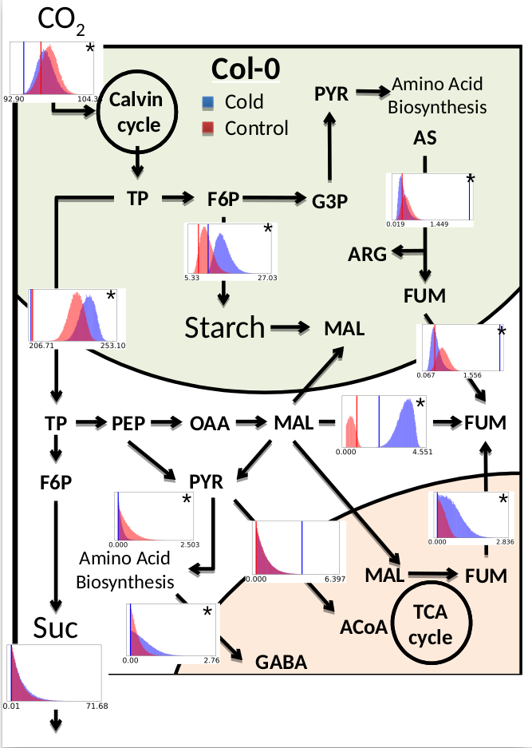
Flux Sampling: A Powerful Tool to Study Metabolism under Changing Environmental Conditions Herrmann et al. 2019, submitted
COBRA(py)
ACHR OPTGP CHRR
Run time & Convergence across 3 metabolic models
Constraint-based modelling without an objective function minimizes observer bias.
Model by Arnold & Nikoloski, 2014

Slide 15
Flux Sampling: A Powerful Tool to Study Metabolism under Changing Environmental Conditions Herrmann et al. 2019, submitted
COBRA(py)
ACHR OPTGP CHRR
+ Metabolite Assays
+ Proteomics
+ Loopless
Run time & Convergence across 3 metabolic models
Constraint-based modelling without an objective function minimizes observer bias.
Model by Arnold & Nikoloski, 2014
Model by Arnold & Nikoloski, 2014

Slide 16
Min-Path Method Ranganathan & Maranas, 2010 M-M Graph Remove small molecules & cofactors Possible Paths Node A – B Check against flux sampling soln's

Slide 17
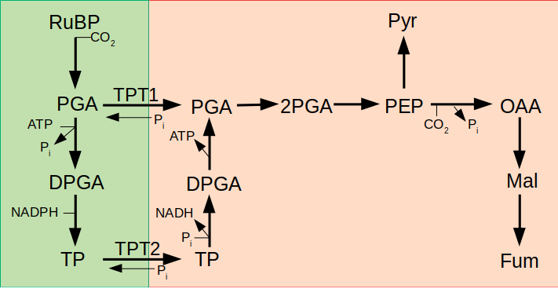
Min-Path Method Ranganathan & Maranas, 2010 M-M Graph Remove small molecules & cofactors Possible Paths Node A – B Check against flux sampling soln's
Two possibilities for carbon export from the chloroplast

Slide 18
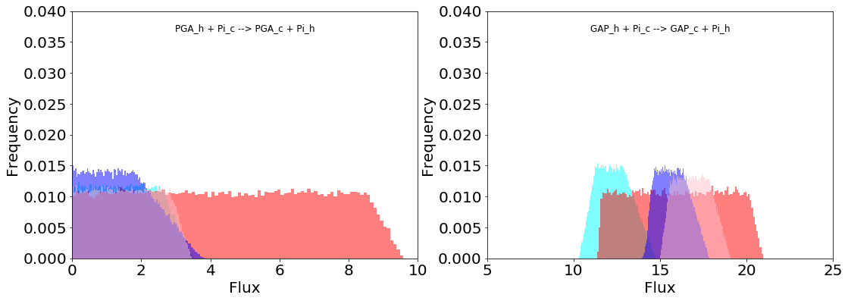
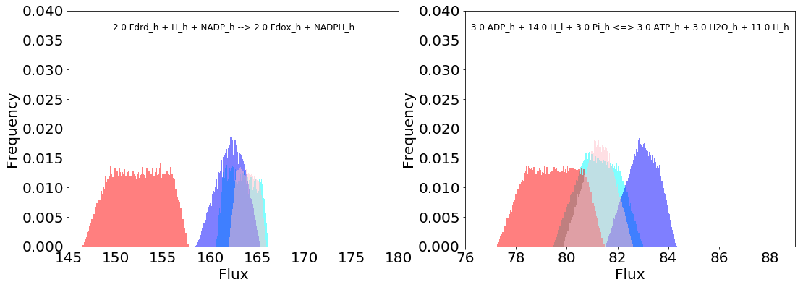
Two possibilities for carbon export from the chloroplast
Col-0 Control
Col-0 Cold
fum2 control
fum2 cold
TPT1 TPT2
TPT2 is the primarily used pathway but there exists some flexibility between the two.
The Col-0 wild-type changes its ATP & NADPH requirements in response to cold.
The fum2 mutant does not.
NADPH ATP

Slide 19
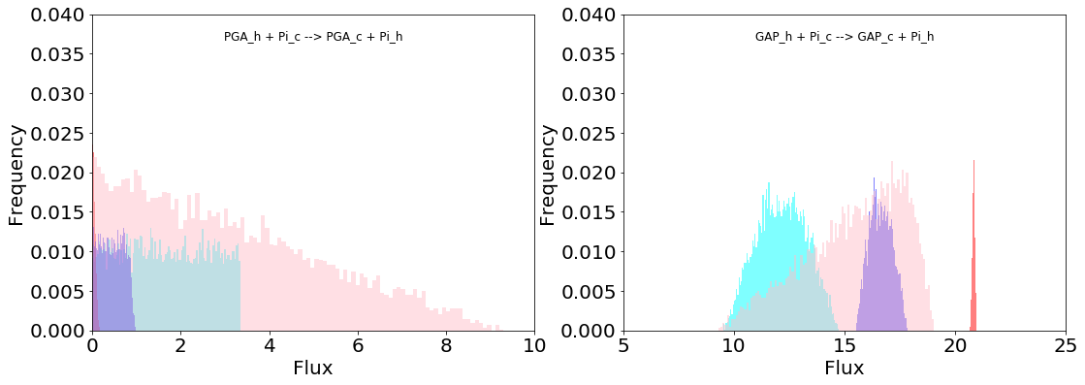
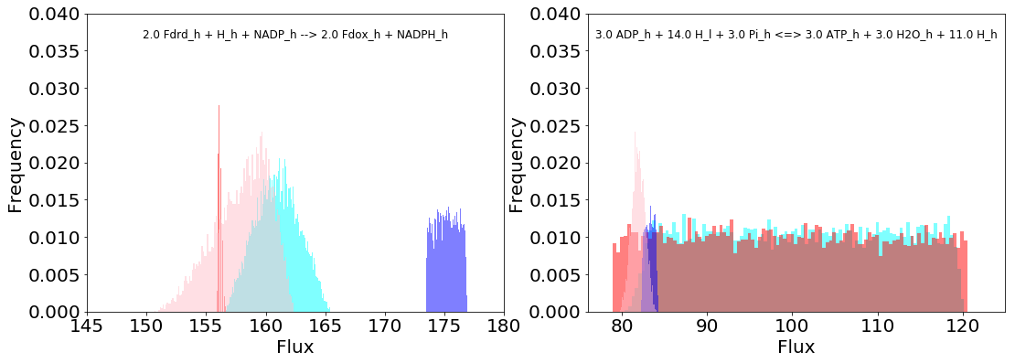
Two possibilities for carbon export from the chloroplast
Col-0 Control
Col-0 Cold
fum2 control
fum2 cold
TPT1 TPT2
Cyclic e transport included
NADPH ATP

Slide 20
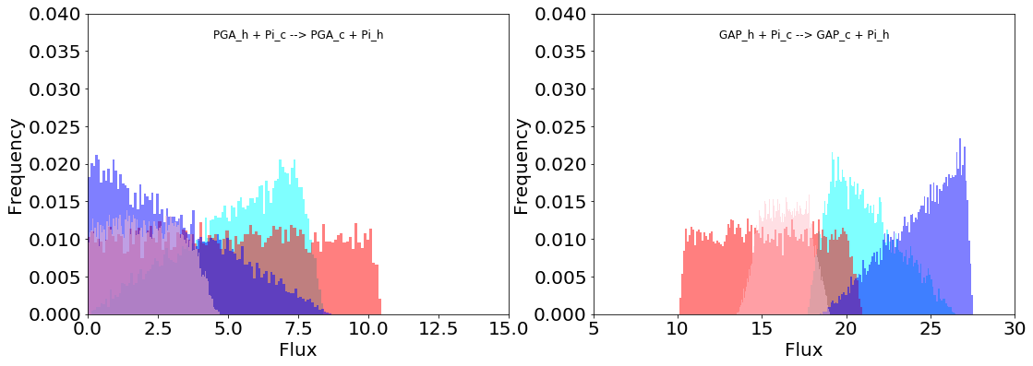
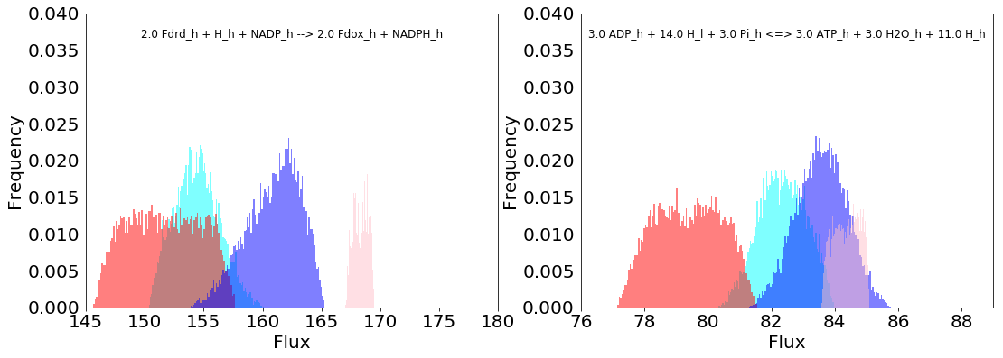
Two possibilities for carbon export from the chloroplast
Col-0 Control
Col-0 Cold
fum2 control
fum2 cold
TPT1 TPT2
Cyclic e transport included
Proteomics constraints removed
NADPH ATP

Slide 21
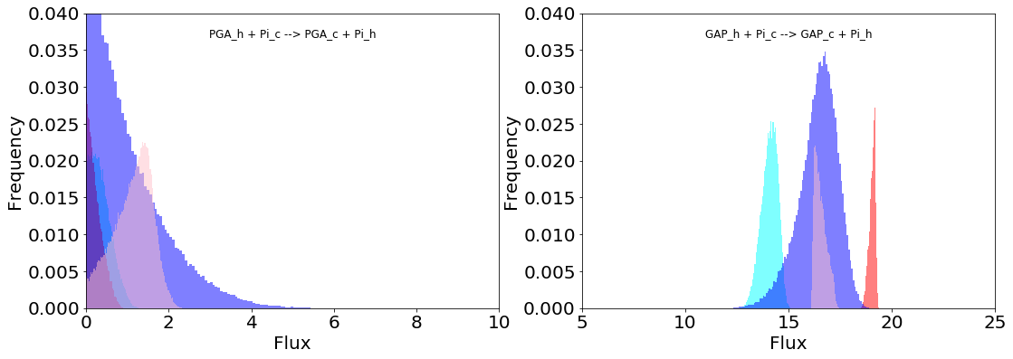
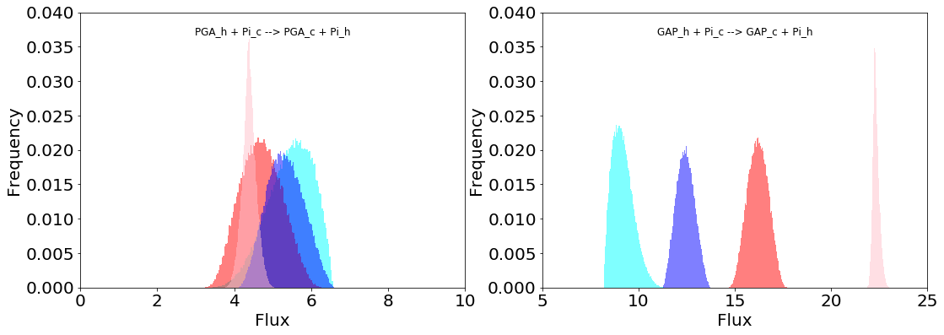
Col-0 Control
Col-0 Cold
fum2 control
fum2 cold
Changing the ATP/NADPH production affects carbon export from chloroplast
Minimum ATP/NADPH
Capacity for TPT1 under high NADPH production is highest for Col0 cold.
TPT1 TPT2
Maximum ATP/NADPH
When conditions are NADPH limited, the TPT1 reaction carries a flux.
TPT1 TPT2
Notes:
Previous work by Savitch et al. 2001 showed that moving plants from 20 to 5 degrees increases NADPH to ATP ratio in response to cold.

Slide 22
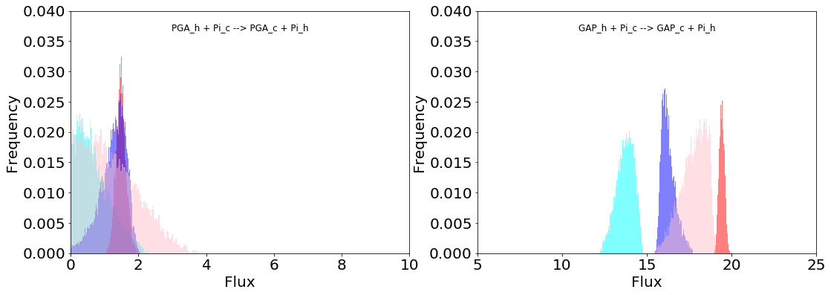
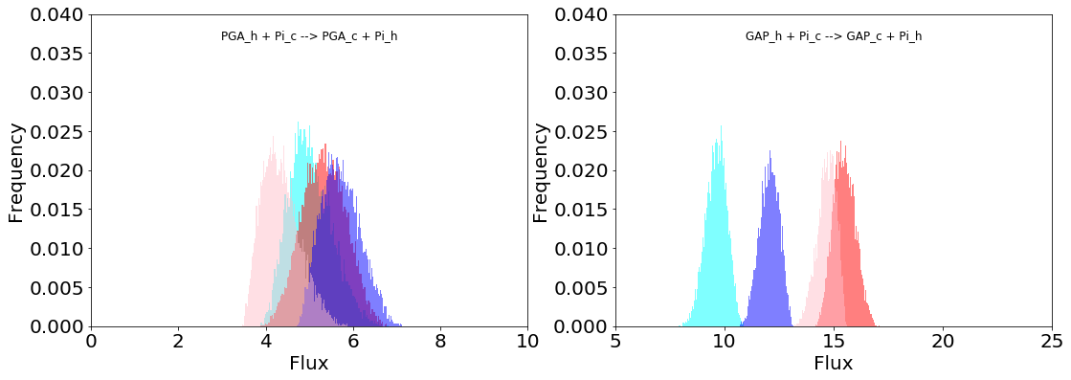
Col-0 Control
Col-0 Cold
fum2 control
fum2 cold
Changing the ATP/NADPH production affects carbon export from chloroplast
Minimum ATP/NADPH
TPT1 TPT2
Maximum ATP/NADPH
TPT1 TPT2
Notes:
Previous work by Savitch et al. 2001 showed that moving plants from 20 to 5 degrees increases NADPH to ATP ratio in response to cold.

Slide 23
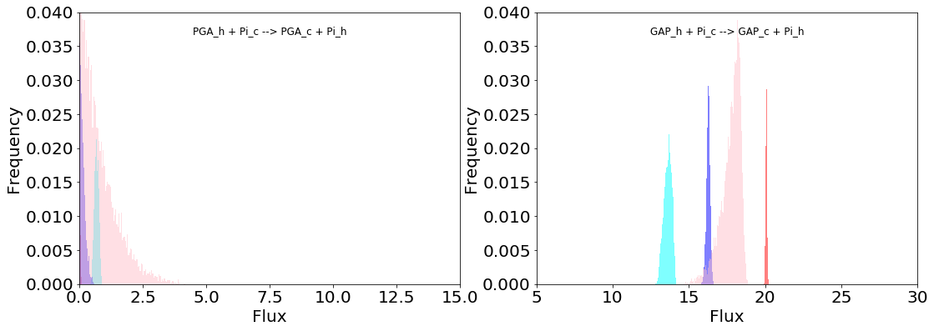
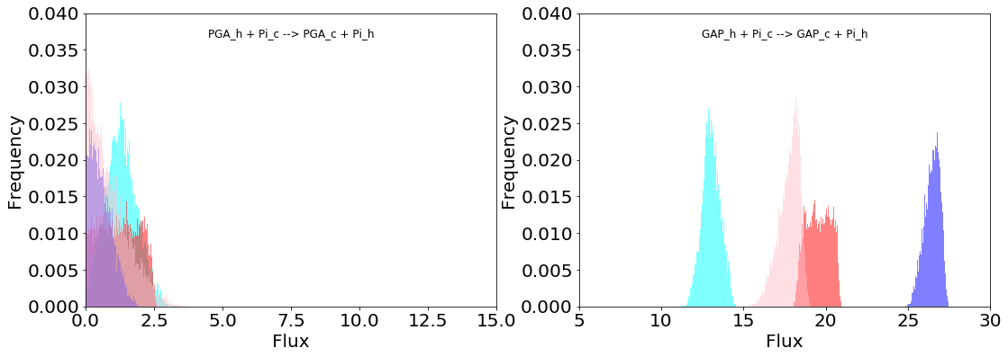
Col-0 Control
Col-0 Cold
fum2 control
fum2 cold
Changing the ATP/NADPH production affects carbon export from chloroplast
Minimum ATP/NADPH
w/o proteomics constraints
TPT1 TPT2
Maximum ATP/NADPH
w/o proteomics constraints
TPT1 TPT2
Notes:
Previous work by Savitch et al. 2001 showed that moving plants from 20 to 5 degrees increases NADPH to ATP ratio in response to cold.

Slide 24
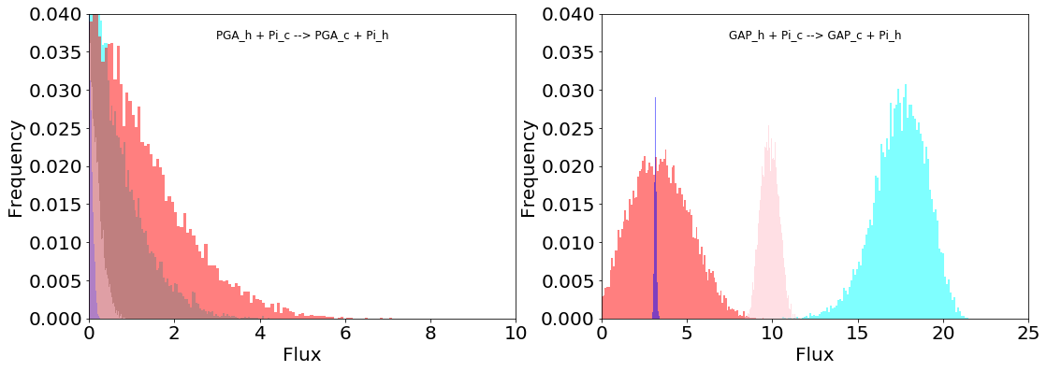
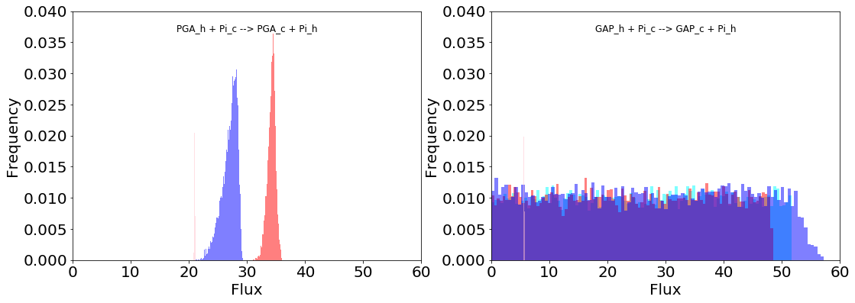
Col-0 Control
Col-0 Cold
fum2 control
fum2 cold
Changing the ATP/NADPH production affects carbon export from chloroplast
Maximum NADPH
TPT1 TPT2
When ATP is unfixed
Minimum NADPH
TPT1 TPT2
Notes:
Previous work by Savitch et al. 2001 showed that moving plants from 20 to 5 degrees increases NADPH to ATP ratio in response to cold.

Slide 25
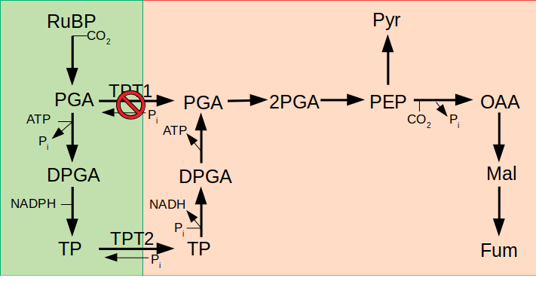
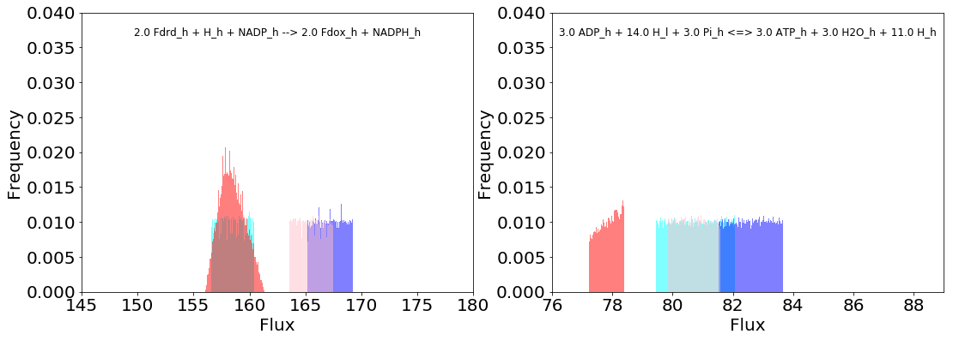
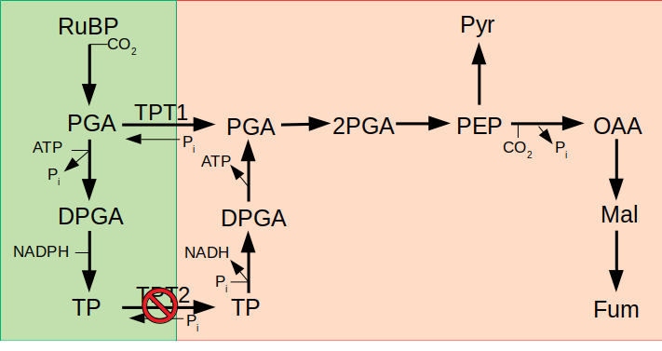
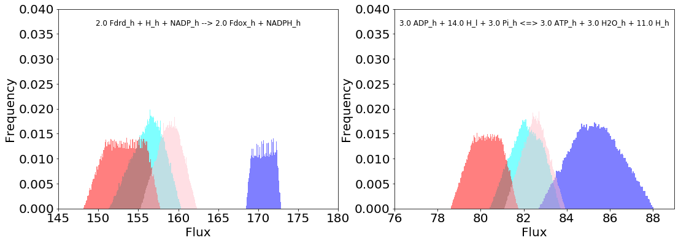
Col-0 Control
Col-0 Cold
fum2 control
fum2 cold
Changing the carbon export changes the ATP & NADPH production
NADPH ATP
NADPH ATP
0.49
0.49
0.51 0.48
0.52 0.50
0.54 0.48

Slide 26
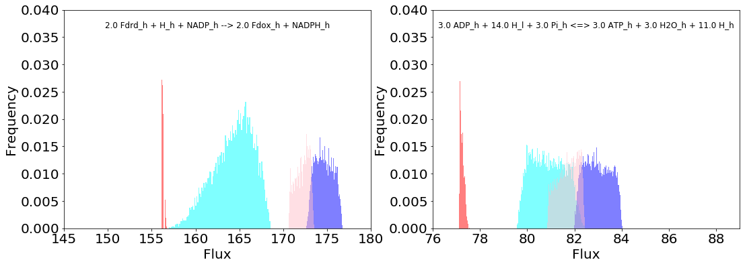
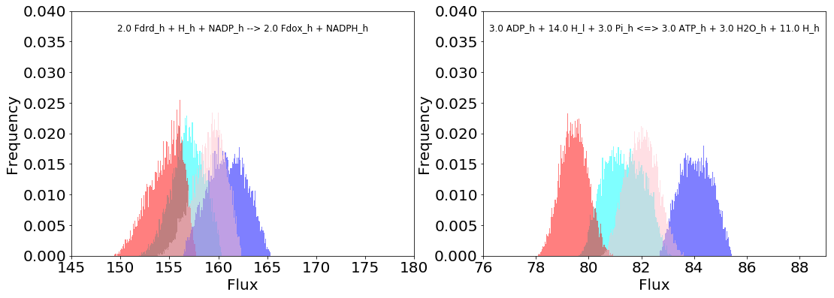
Col-0 Control
Col-0 Cold
fum2 control
fum2 cold
Changing the carbon export changes the ATP & NADPH production
NADPH ATP
NADPH ATP
0.49
0.49
0.51 0.48
0.52 0.50
0.54 0.48

Slide 27
Conclusions
Flux sampling is a useful tool for dynamic acclimation studies
No objective function(s) required – Exploratory
Two possibilities for carbon export from the chloroplast
Changing ATP/NADPH requirements affects carbon export from the chloroplast
Notes:
OAA might accumulate because of PGA export when NADPH is limited
When NADPH is increased fumarate stores energy

Slide 28



Acknowledgements
Prof Johnson and Lab
Dr Schwartz and Lab
Dr Beth Dyson
Lucy Vass

